Slide 1
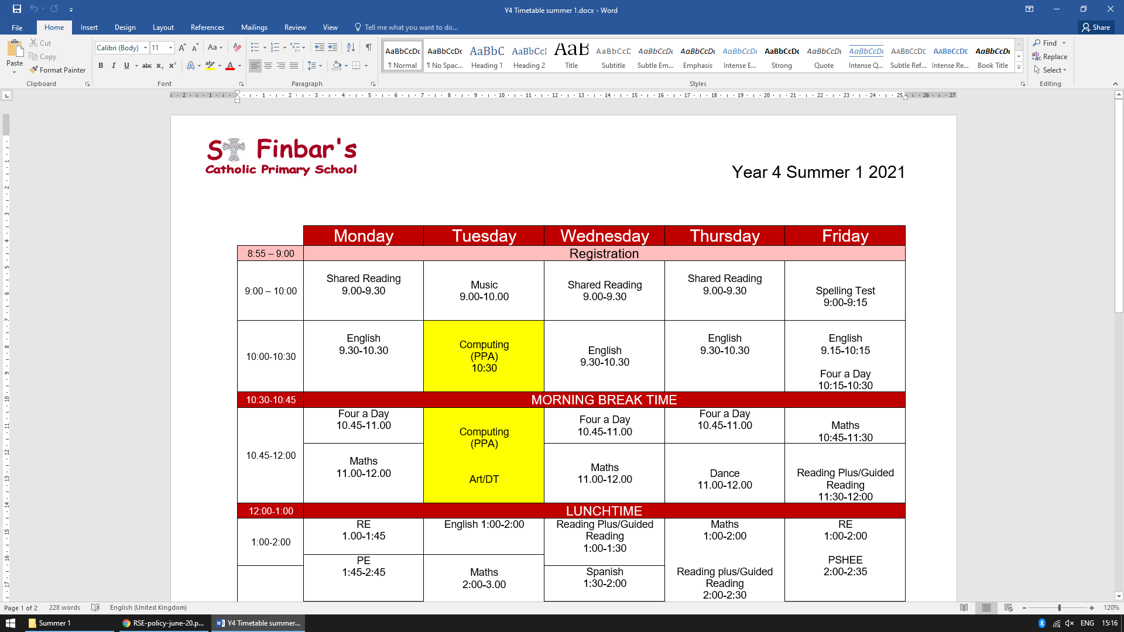
Relationships & Sex Education
May 2021

Slide 2
Agenda
Welcome and introduction
Why we teach Relationship and Sex Education (RSE)
What is “A Journey in Love”?
How will it be taught in St. Finbar’s school?
What will my children be learning about?
Can I withdraw my child from RSE lessons?
Opportunity to look at the materials and ask questions
Reflection and feedback

Slide 3
DEFINING RELATIONSHIP AND SEX EDUCATION
The DfE guidance states that “… children and young people need to know how to be safe and healthy, and how to manage their academic, personal and social lives in a positive way”. It is about the development of the pupil’s knowledge and understanding of her or him as a sexual being, about what it means to be fully human, called to live in right relationships with self and others and being enabled to make moral decisions in conscience.
In primary schools the focus should be on “teaching the fundamental building blocks and characteristics of positive relationships, with particular reference to friendships, family relationships, and relationships with other children and with adults.” This would include the topics of families and the people of who care for me, caring friendships, respectful relationships, online relationships and being safe.

Slide 4
Why do we teach RSE?
Why we teach RSE
Relationships and Sex Education (RSE) is the life-long learning about physical, moral social and emotional development
It is the understanding of the importance of marriage for family life, stable and loving relationships, respect, love and care
It is also about the teaching of sex, sexuality and sexual health
The teaching of RSE comes from “A Journey in Love”

Slide 5
What is A Journey in Love?
The central message of the Christian faith is love.
The central message of our RSE teaching is love.
“My commandment is this: love one another, just as I have loved you”
John 15:12
A Journey in Love is a resource created by Sister Jude Groden of BRES.
It is the recommended programme of study for Catholic schools for Sex and Relationship Education, and has been written as a progressive scheme of work that supports the Religious Education, PSHE and Science curricula taught within the school. It is approved by the Council of Catholic Bishops of England and Wales.
Through out Journey in Love, an aspect of the mystery of love is focussed upon in each group, children and young people are encouraged to marvel at the wonder and beauty of God’s creative love.

Slide 6
What is A Journey in Love?
This is reflected in each stage of a person’s growth in the Primary Years through a series of suggested, progressive and developmental tasks, activities and reflections which focus on physical, social, emotional, intellectual and spiritual development.
As with all aspects of learning, children are naturally curious and many will have questions related to their lessons. Opportunities to discuss questions form part of the lessons and again these are treated with care and understanding.
A Journey in Love highlights the importance of parental input and children will be told to discuss their lessons at home.

Slide 7
How will it be taught in St. Finbar’s school?
A Journey in Love programme of learning is broken into 4 aspects of human development:
Physical
Social
Emotional
Intellectual
Each aspect is then broken down into:
Activities
Pause & Reflect
Prayer
All sessions follow this format

Slide 8
What will my child be learning about?

Slide 9
EYFS
Children begin to explore the wonder of being special and unique.
Examples of Early Years questions:
Why are you special to your family?
How do you know that you are special?
What do you love and enjoy about belonging to your family?
Who would you go to if you felt worried or needed help?
How does God show love to you and your family?

Slide 10
Year 1
Children focus on families and specially growing up in a loving, secure and stable home.
Examples of Year 1 questions:
How is love shown in your family?
Why are the words ‘please’, ‘thank you’ and ‘sorry’ important to create a happy family?
Why is teasing and bullying wrong and unacceptable within families and friendships?
Why should we always tell the truth?

Slide 11
Year 2
Children describe how we are growing and developing in diverse communities that are God-given.
Examples of Year 2 questions:
How would you describe a community?
What are the joys of belonging to a community?
How do different individuals enrich a community?
What do you bring to the community that you belong to?

Slide 12
Year 3
Children describe and give reasons for how we grow in love and caring and happy friendships where we are secure and safe.
Examples of Year 3 questions:
How do friendships make us feel happy and secure?
How can friendships change?
Why is violence never the answer?
What Bible stories teach us about the beauty of forgiveness?

Slide 13
Year 4
Children make links and connections to show that we are all different. They learn to celebrate these differences as we appreciate that God’s love accepts us as we are now and as we change.
Examples of Year 4 questions:
In what ways is being polite and courteous helping to make a better world to live in?
How do authority figures help communities and societies work together better?
How do we respect others even when they are different from ourselves?
How can your gifts be used for the common good?

Slide 14
Year 5
Children know and become aware of the physical and emotional changes that accompany puberty- sensitivity, mood swings, anger, boredom, etc.
They grow further in their understanding of God’s presence in their daily lives.
Examples of Year 5 activities:
Identify and celebrate the ways I have changed since birth
Discuss the external and internal changes which happen to boys and girls in puberty- pupils may be divided into male and females and taught separately for this section of the unit
Recognise behaviour changes as we grow up
Identify that physical changes from child to adult means the ability to become a mother or father
Reflect on ways to become more sensitive to the emotional development of oneself and of others

Slide 15
Year 6
Children develop a secure understanding of what stable, caring relationships are and the different kinds there may be. Focusing on Catholic teaching, children will also know and understand about the conception of a child within marriage.
Examples of Year 6 activities:
Explain how human life is conceived
Recognise Male and female reproductive organs- children may be separated into males and females for this section
Know that sexual intercourse occurs between husband and wife
Understand how a child grows within the mother’s womb
Understand that God causes new life to begin through the love that parents have for each other
Celebrate God’s creative love in creating us as his children

Slide 16
Can I Withdraw my child?
Parents continue to have the right to withdraw their children from Relationship & Sex Education except in those elements which are required by the National Curriculum science orders.
Should parents wish to withdraw their children they are asked to notify, in writing, the school by contacting the headteacher. The school will provide support by providing material for parents to help the children with their learning.

Slide 17
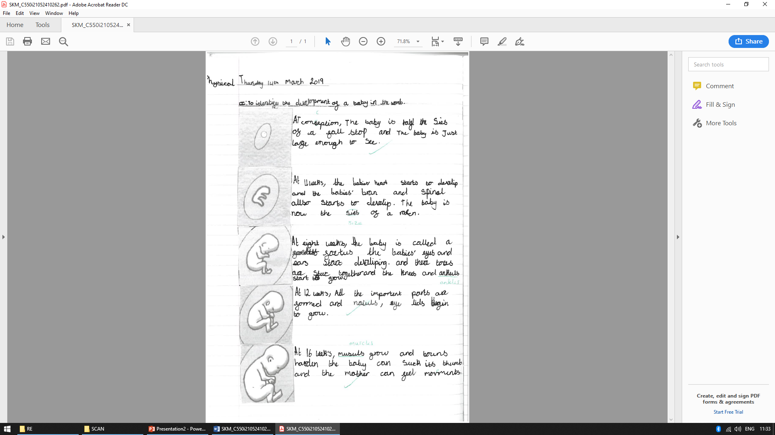
Examples of work

Slide 18
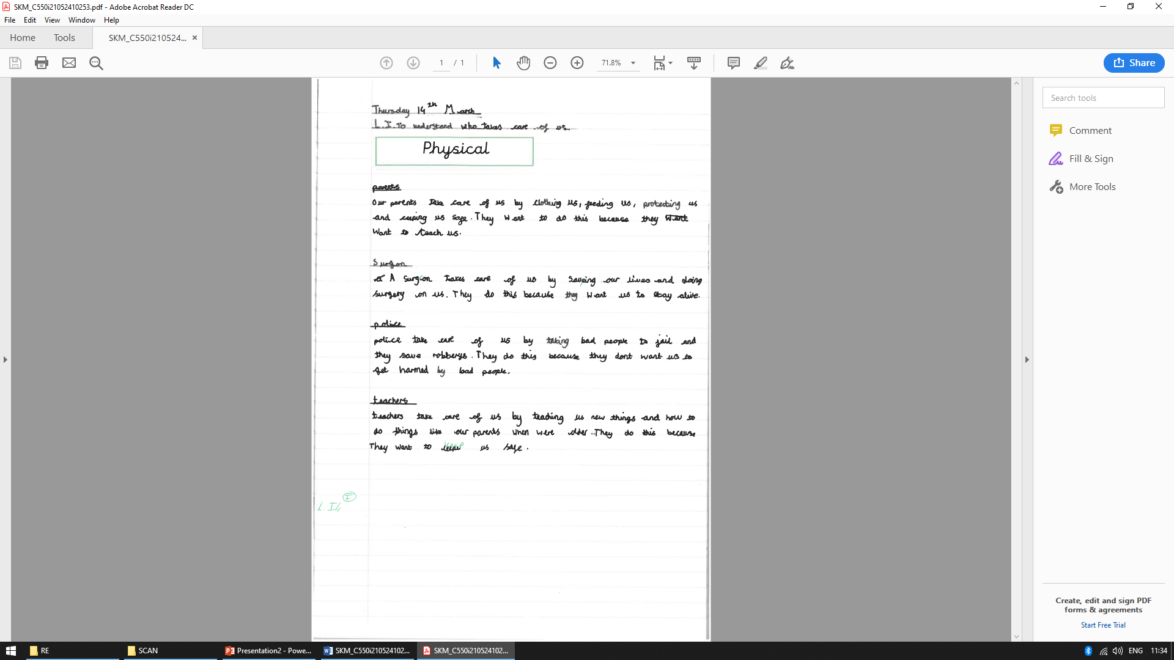

Slide 19
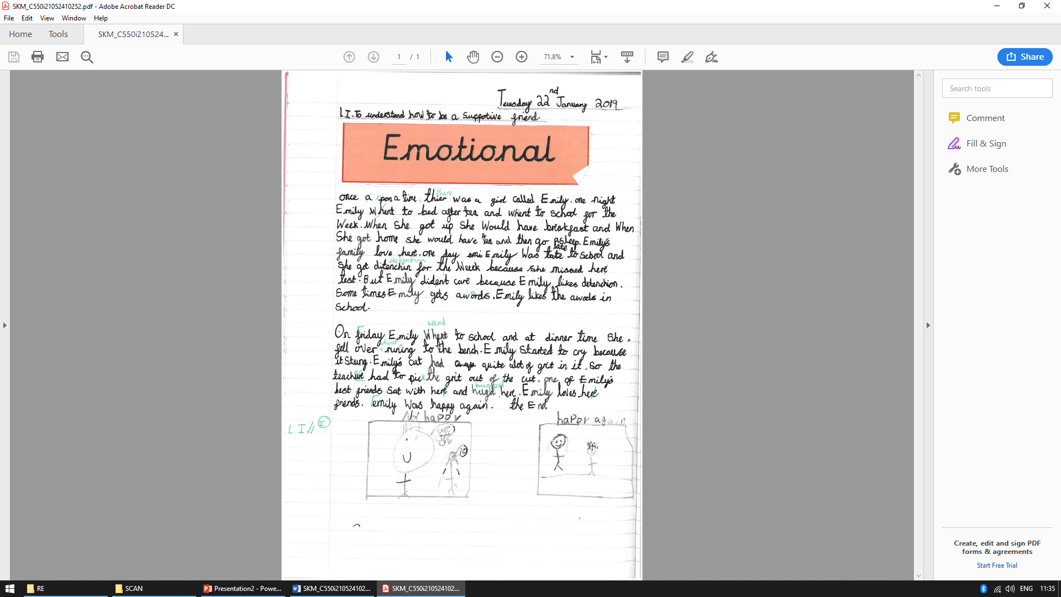

Slide 20
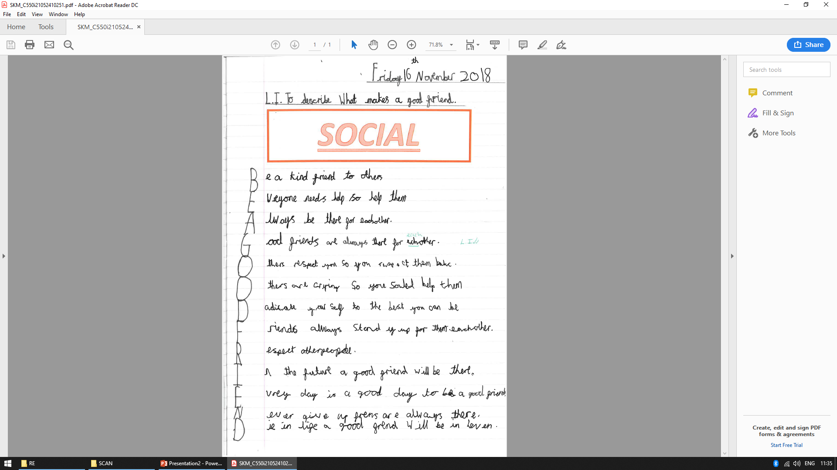

Slide 21
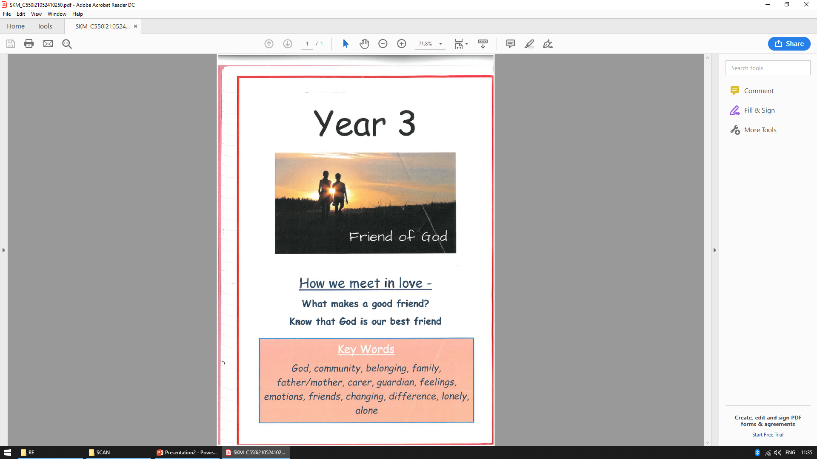

Slide 22
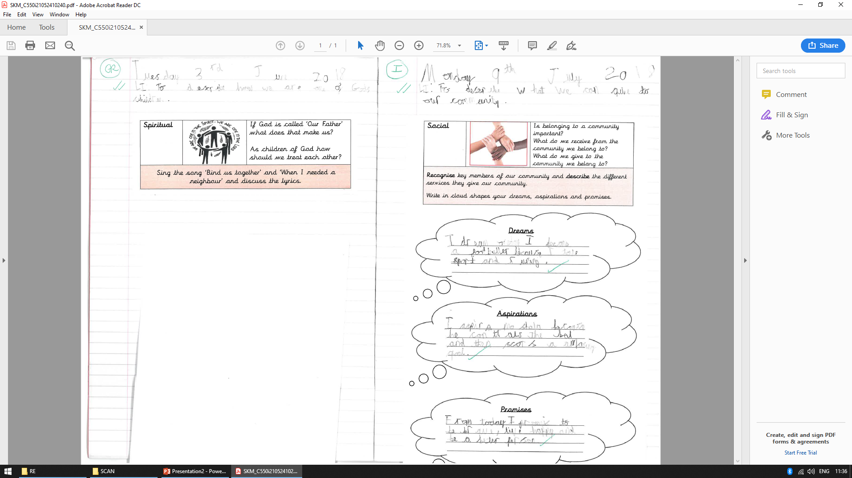

Slide 23
Year group Core Vocabulary – EYFS & KS1
EYFS
God, Unique, Different, Special, Eyes, Hair, BoyI Girl, Hands, Fingers, Name, Family, Love, Womb, Describe
Year 1
Unique, friend, God, Important, different, special
Year 2
God, community, belonging, family, mother, father, carer, guardian, feelings, emotions

Slide 24
Year group Core Vocabulary – KS2
Year 3
Community, Belonging, Family, Father/mother, Carer/guardian, Feelings, emotions,
Year 4
Talents, difference, development, change, male and female body parts, conflict, appreciate, celebrate, achievement, conception, womb
Year 5
God, sensitivity, puberty, presence, celebrant, external, internal, change, develop, Ovulatuion, menstruation, reproduction, hormones
Year 6
God, Christian, Appropriate, Dignity, Sexuality, Intercourse, Fallopian, Conceive, Relationship, Uterus, Cervix, Marriage, Fiancé, Fiancée

Slide 25
Reflection, questions and feedback

